Slide 1

Parent Engagement Survey Results
PETHS School Council
October 25- November 22 2024
January, 2025

Slide 2
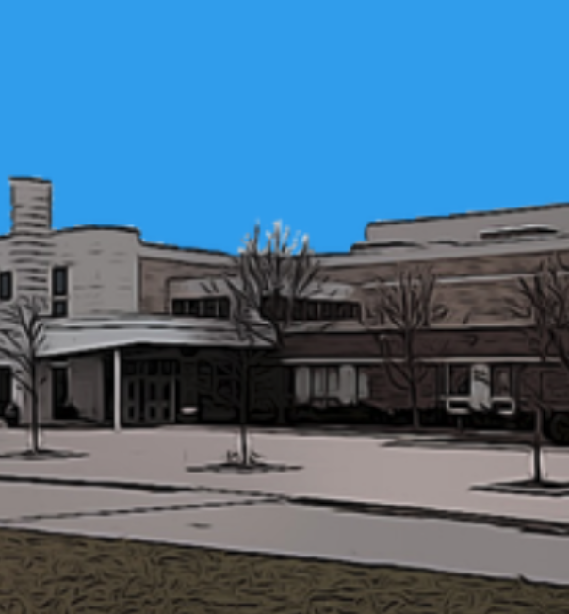
Intro
Parent Engagement Survey
The school council conducted a survey to get feedback on parent perceptions of the school and to ask for ideas on improving parent engagement and fundraising
PETHS School Council
Objective

Slide 3





What we like…
Teachers and Staff
Clubs and Actvities
Learning Environment
Focus on Academics
Services and Support
50%
33%
27%
20%
17%
PETHS School Council
Positive Perceptions

Slide 4
Issues and Suggestions
Staff/Teacher Improvements
Course Timetable Scheduling/Staffing
University/College Info Sessions
Vaping/Washroom Maintenance
Improve Road Safety
School Council Meetings: Offer Virtual/Online Meeting Options

Slide 5
Workshops
Preparing for Post-Secondary Pathways
How to Communicate with Your Teen
Preparing for Trades/Apprenticeship Pathways
Mental Health and Wellness
Meet and Greet
Socials and Coffee/Tea nights to meet other parents in your child’s grade
Board game nights or family social activity nights
Family Board Game/Actvity Social
PETHS School Council
Parent Engagement Feedback

Slide 6
Thank You

